Slide 1
Unit 10 Analyzing Data Displays
Algebra 1

Slide 2
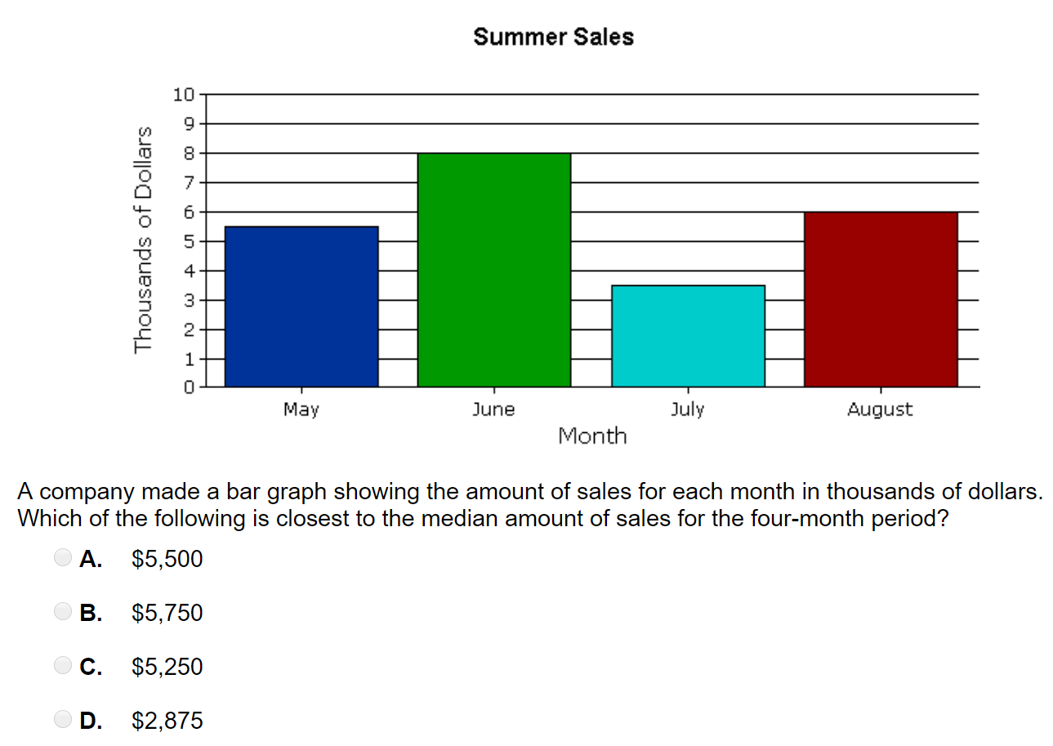
BAR GRAPH

Slide 3
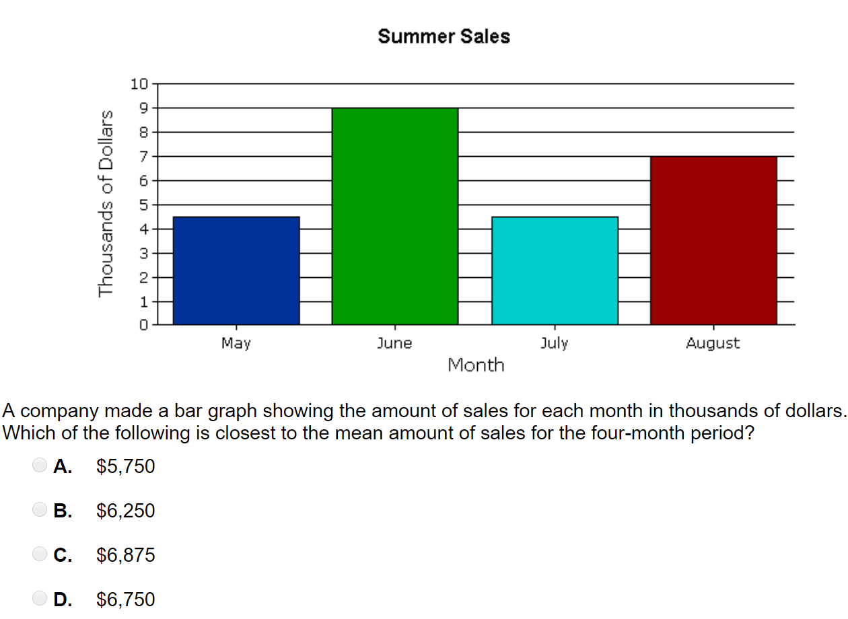

Slide 4
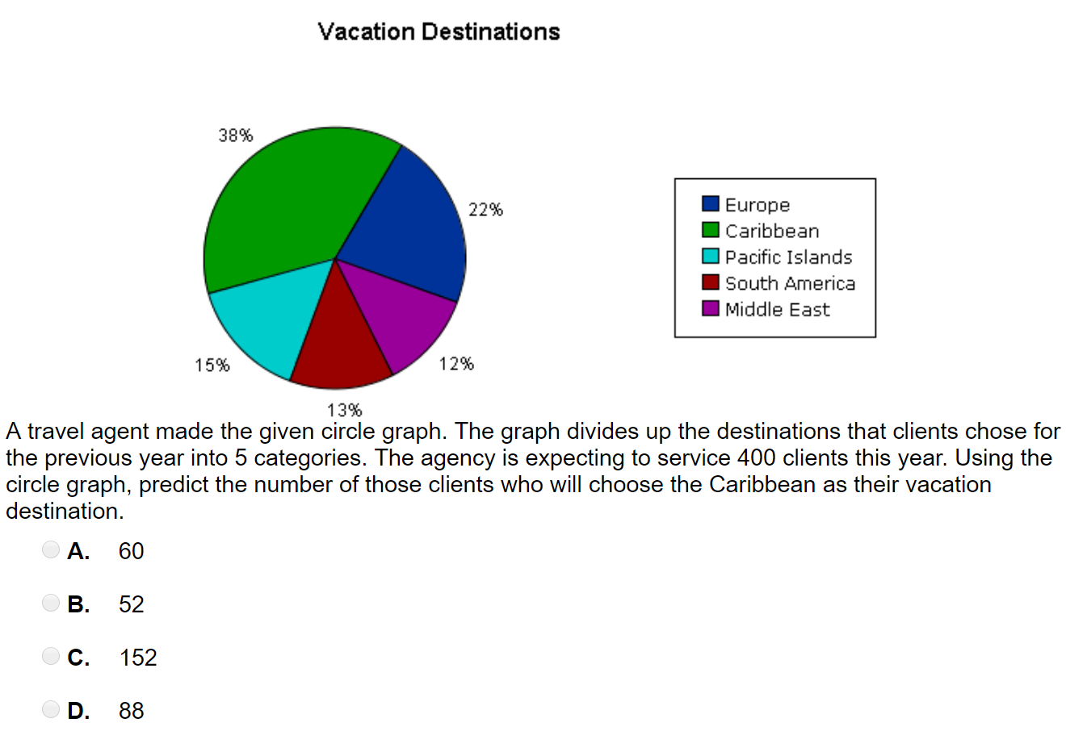
Pie Chart

Slide 5
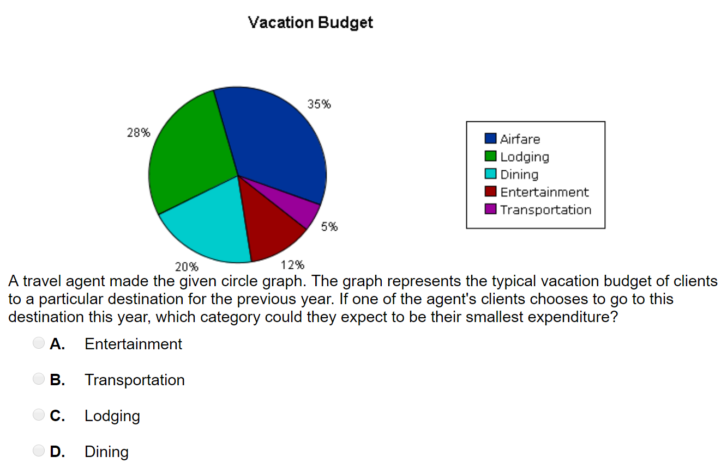

Slide 6
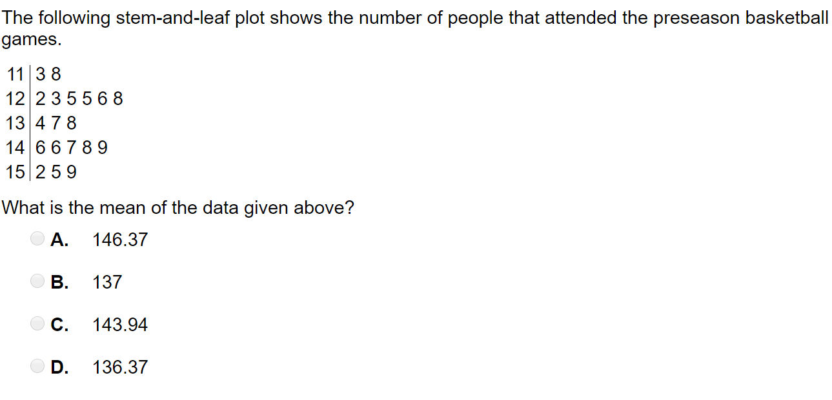
Stem and Leaf Plot

Slide 7
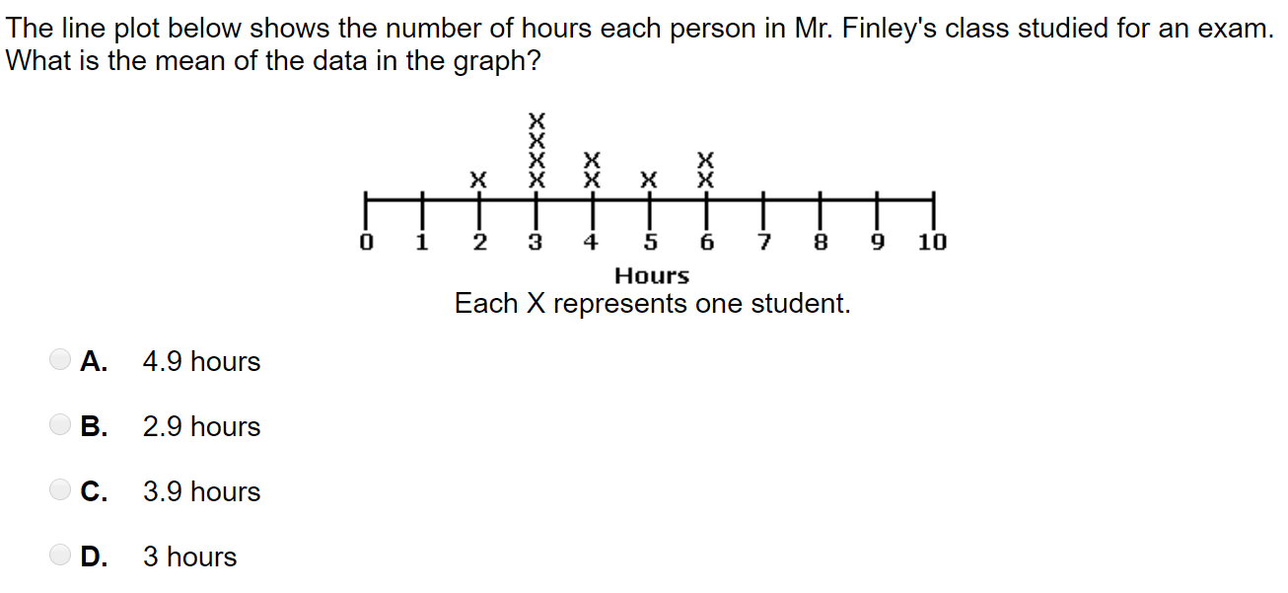
Line Plot

Slide 8
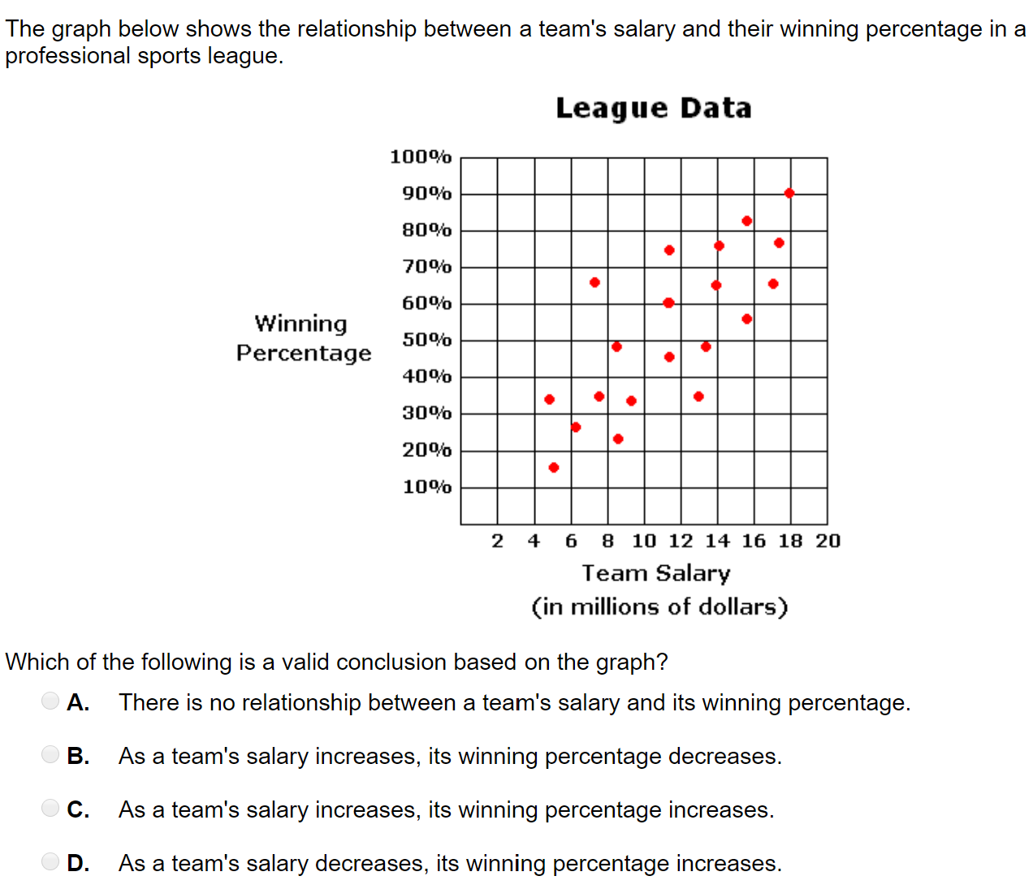
Scatter Plot

